Slide 1
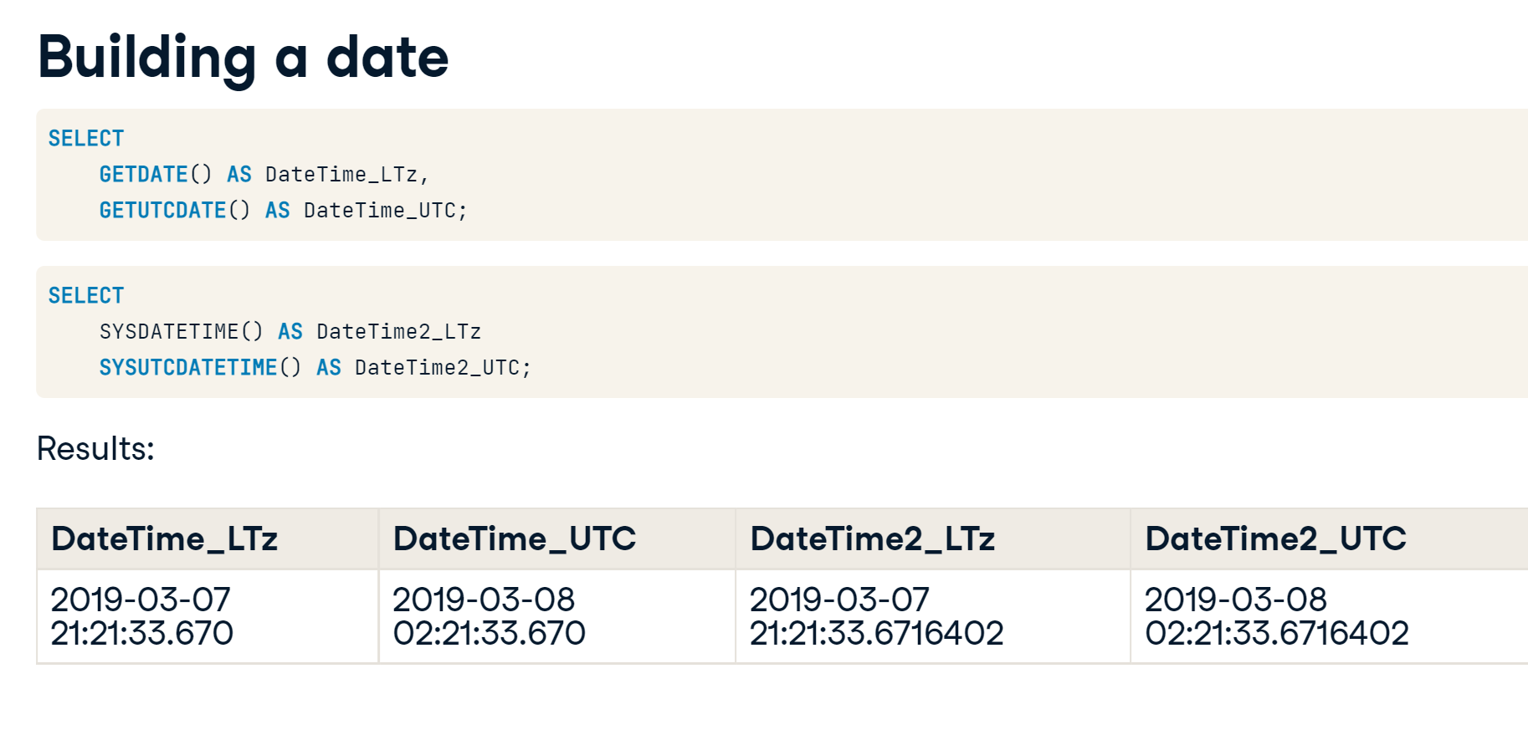

Slide 2
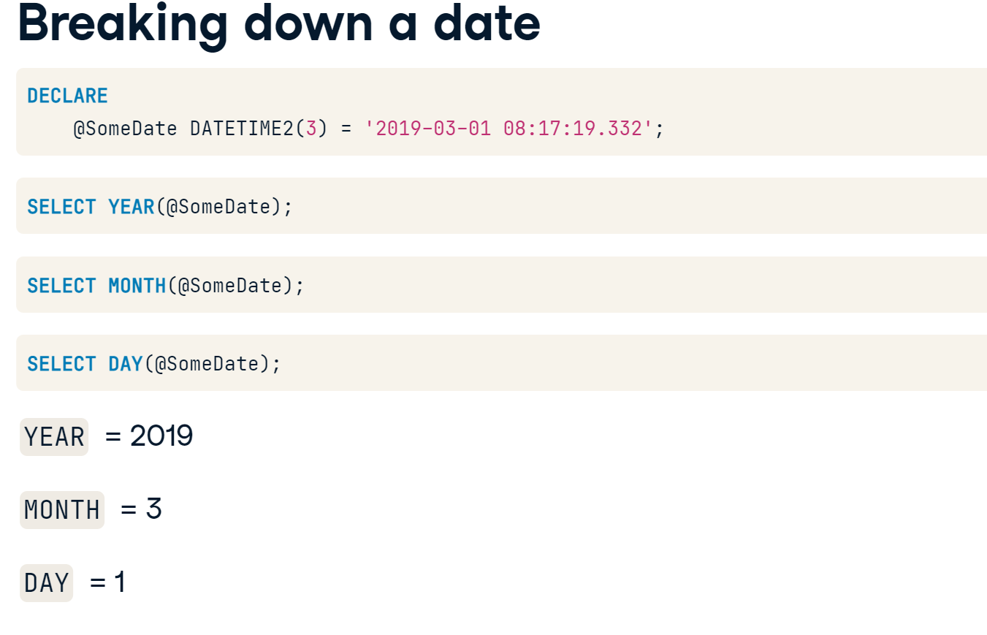

Slide 3
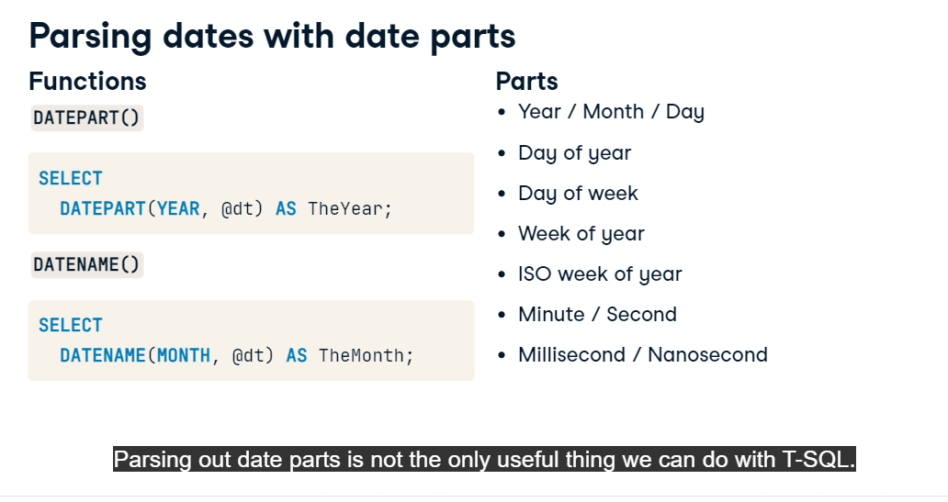
https://docs.microsoft.com/en-us/sql/t-sql/functions/datepart-transact-sql?view=sql-server-ver15 https://docs.microsoft.com/en-us/sql/t-sql/functions/datename-transact-sql?view=sql-server-ver15

Slide 4
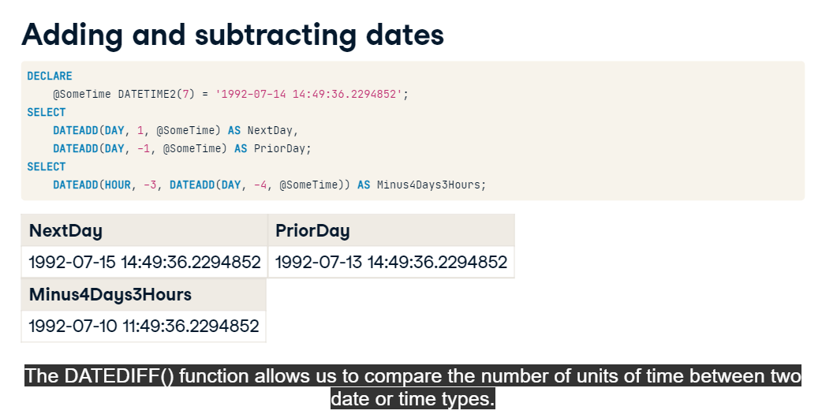

Slide 5
